Slide 1
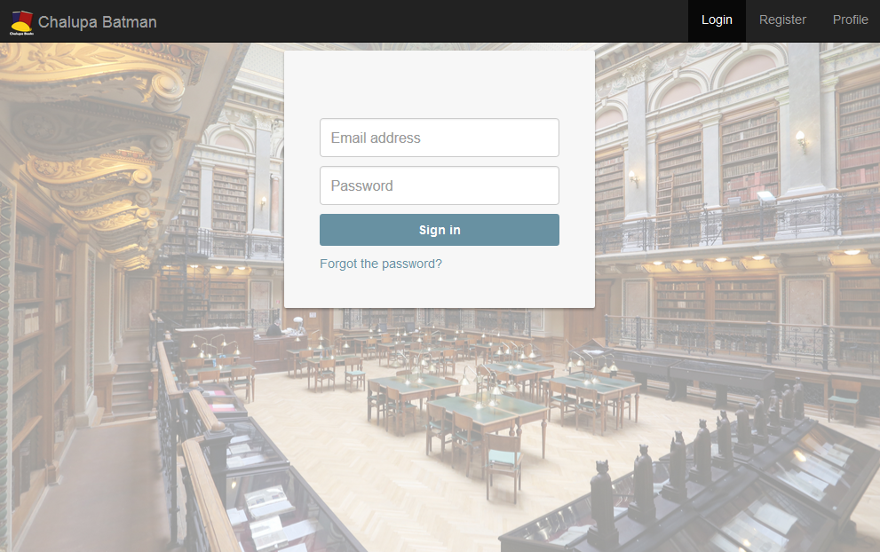
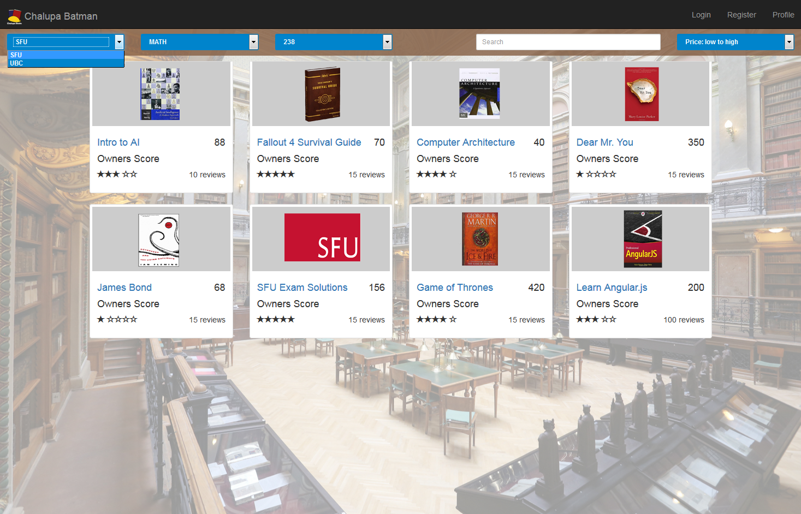
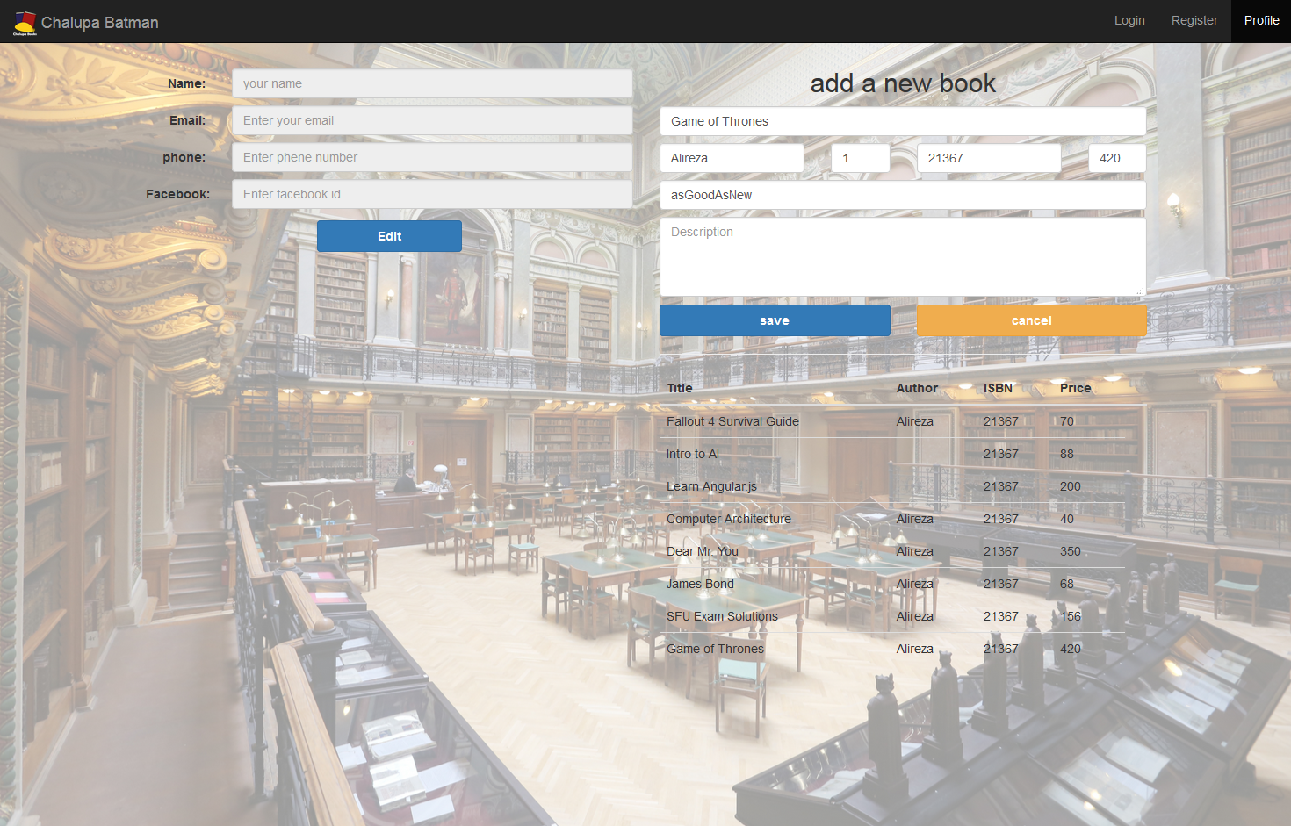
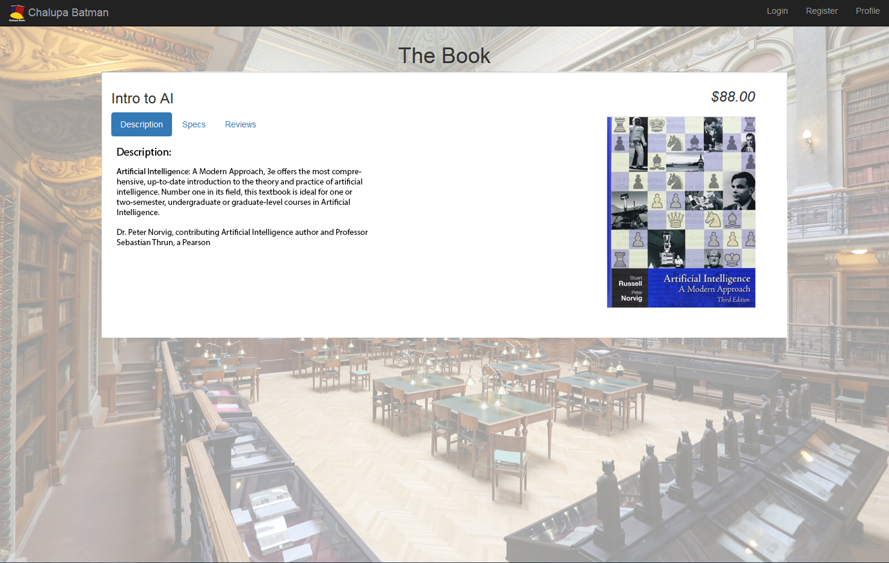
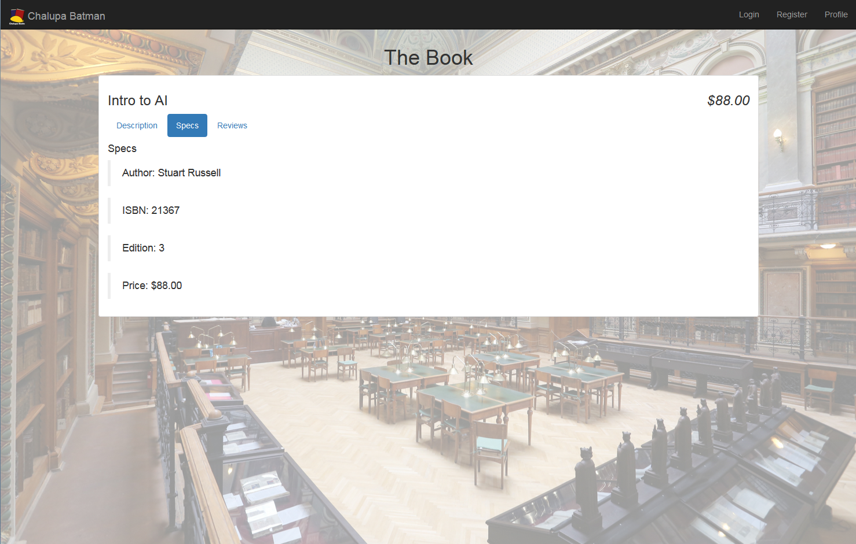
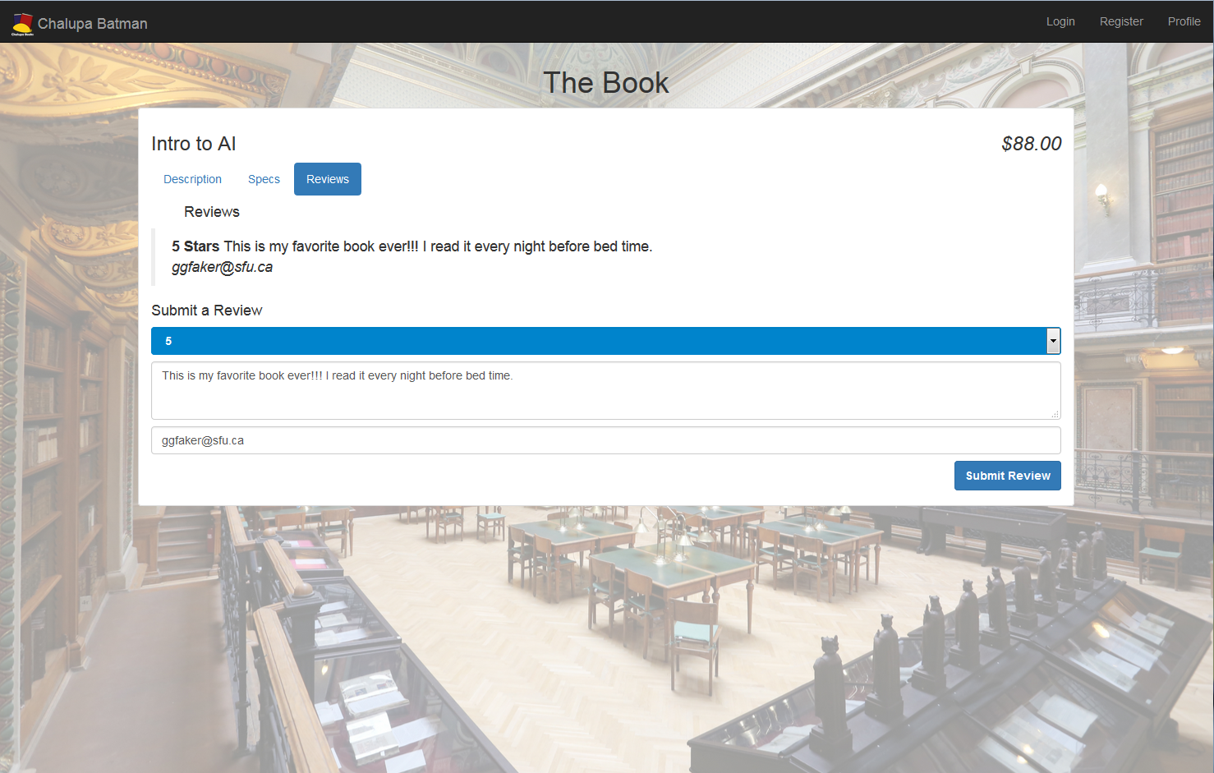
Purpose:
convenient exchange of textbooks between students
How:
Sign up and list books for sale
Find books by school, department and course
Purchase textbooks from thousands of active users
Contact sellers through email and phone
Sign in / Register
Technology:
Ruby on Rails
Angular.js
Bootstrap
Home page
Profile/
Post book
Individual book pages
Individual book pages
Individual book pages
CMPT 470 – Group #3: Alireza Alidousti | Beau Grier | Wan Weng Lo | Daniel Soheili | Archit Sood | Randy Yuan

